Slide 1


SMART INDIA HACKATHON 2025
TITLE PAGE
Problem Statement ID – 25016
Problem Statement Title- Automated Student Attendance Monitoring and Analytics System for Colleges
Theme- Smart Education
PS Category- Software
Team ID- S113
Team Name- paradox

Slide 2
No More Roll Call: Face Recognition to the Rescue
paradox
PROPOSED SOLUTION: Facial Recognition Attendance System
Solution Overview
AI-powered facial recognition model detects student faces in real-time via camera.
Automatically marks attendance in a CSV database (Name, Date, Time) while avoiding duplicates.
Unknown faces can be registered instantly, updating the dataset dynamically.
Generates structured attendance reports for faculty/admins.
How it Addresses the Problem
Eliminates manual roll calls & proxy attendance.
Provides real-time, accurate, and transparent attendance records.
Innovation & Uniqueness
Dynamic dataset updating for new students without restarting system.
Real-time recognition + automatic reporting in a single workflow.
Combines AI facial recognition + cloud-based analytics, unlike traditional or QR-based methods.

Slide 3
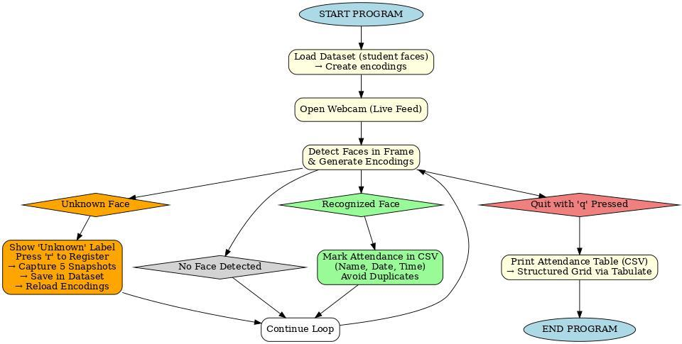
TECHNICAL APPROACH
Paradox
Programming Language:
Python, HTML/CSS/JavaScript
Frameworks & Libraries:
Face Recognition / Computer Vision
OpenCV
face_recognition (dlib + NumPy)
Pandas, CSV
Tabulate
Backend & Web Framework:
FastAPI
uvicorn
Development Environment:
Visual Studio Code (VS Code) – Code editor & execution
Storage:
Local File System (Dataset images)
CSV Attendance Logs
Hardware:
Laptop/PC with Webcam (for prototype testing)
Central IP Camera / CCTV(for real deployment in classrooms)

Slide 4
FEASIBILITY AND VIABILITY
paradox
Analysis of the feasibility of the idea
The Face Scanning Attendance System offers real-time, automated attendance using facial recognition, saving time and reducing faculty workload. Though it needs quality hardware and setup, it ensures long-term efficiency. Legal and ethical concerns are addressed through data privacy measures and consent. With awareness efforts, it can modernize attendance in schools.
Challenges & Risks
Data privacy of facial images.
Accuracy issues (lighting, masks, camera quality).
Infrastructure cost (cameras, servers).
Adoption resistance from students/faculty.
Strategies for overcoming these challenges
Take student consent, ensure data is only for attendance, and secure it with encryption, strong passwords, and limited access.
Use high-quality cameras and advanced face recognition software; ask students to keep faces clear, with manual checks for unusual cases.
Use hybrid cloud + edge devices, start with pilot rollout.
Awareness sessions, simple & user-friendly interface.

Slide 5
IMPACT AND BENEFITS
paradox
Impact on Target Audience
Students – Fair, transparent, error-free records.
Faculty – Saves lecture time, effortless tracking.
Institutions – Real-time insights & smart campus image.
Benefits
Social: Eliminates proxy attendance, improves accountability, early risk detection.
Economic: Cuts admin costs, reduces manual effort, scalable & cost-effective.
Environmental: Paperless system, supports sustainable digital transformation.

Slide 6
RESEARCH AND REFERENCES
paradox
The ideation and problem-solving for the Face Scanning Attendance System originated entirely from our team—we identified the challenges with traditional attendance methods and developed an innovative solution using facial recognition technology. The concept, including its benefits, feasibility, and potential impact, was thoroughly planned and structured by us. However, to move the idea from concept to implementation and understand how to bring it into a practical, working system, we sought external guidance. This support helped us better understand the technical requirements, tools, and processes needed to turn our idea into reality. While the core innovation is our own, the assistance we received played a key role in shaping the execution pathway.

